Slide 1
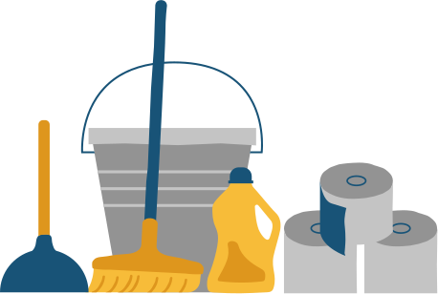
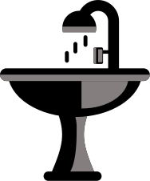
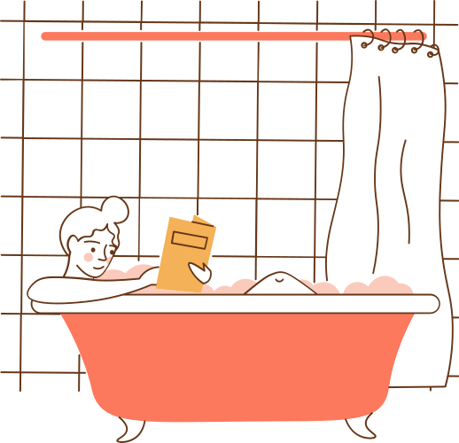
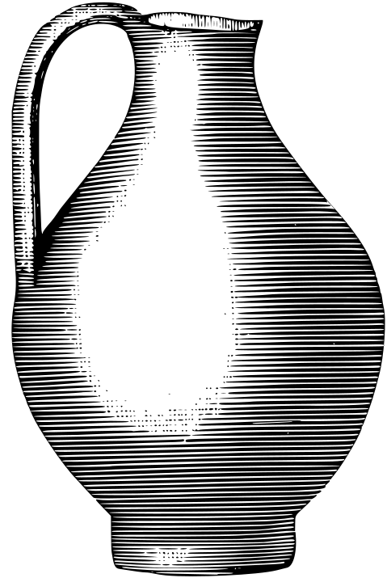
Ceramics
BY
CSE – 21’
Roll No : 8-14

Slide 2








Team Members
Adithya Krishnan
Adlu Rahman
Amy Susan Babu
Aman Nair
Anand Abraham
Anishwar
Aravind J.L

Slide 3

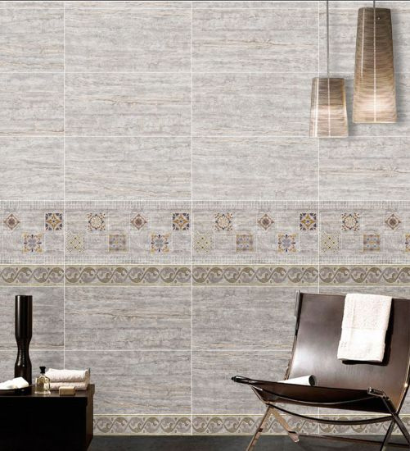
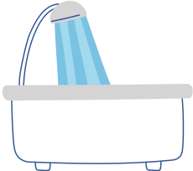
CONTENTS
Introduction
Properties
Classification
Uses Of Ceramics
Advantages And Disadvantages

Slide 4
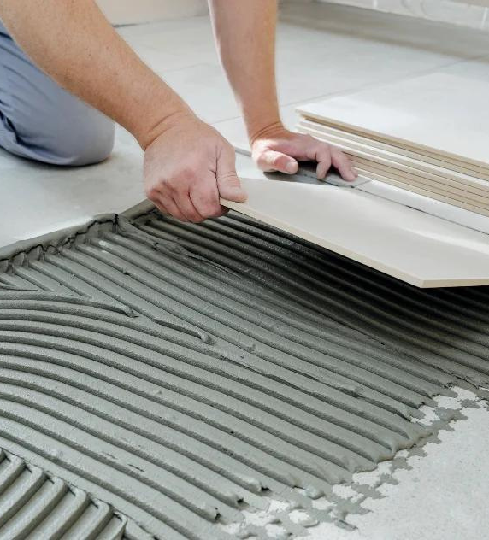
Introduction

Slide 5
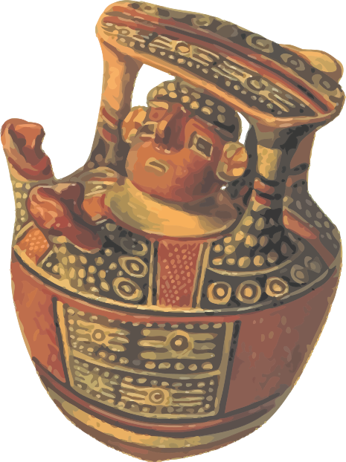
What are Ceramics?
"
A ceramic is any of the various hard, brittle, heat-resistant and corrosion-resistant materials made by shaping and then firing an inorganic, nonmetallic material, such as clay, at a high temperature. Common examples are earthenware, porcelain, and brick.
The word "ceramic" comes from the Greek word κεραμικός (keramikos), "of pottery" or "for pottery",from κέραμος (keramos). The earliest known mention of the root "ceram" is the Mycenaean Greek ke-ra-me-we, workers of ceramic written in Linear B syllabic script.
The word ceramic can be used as an adjective to describe a material, product or process, or it may be used as a noun, either singular, or more commonly, as the plural noun "ceramics".
"

Slide 6

What are Ceramics?
"
Ceramics are generally made by taking mixtures of clay, earthen elements, powders, and water and shaping them into desired forms. Once the ceramic has been shaped, it is fired in a high temperature oven known as a kiln. Often, ceramics are covered in decorative, waterproof, paint-like substances known as glazes.
Based on raw materials and other factors, ceramics can be divided into two - Traditional Ceramics and Advanced Ceramics
Traditional ceramics are clay-based. Advanced ceramics are being developed from a far wider range of inorganic non-metal materials. They have high strength, hardness, durability and toughness.
"

Slide 7
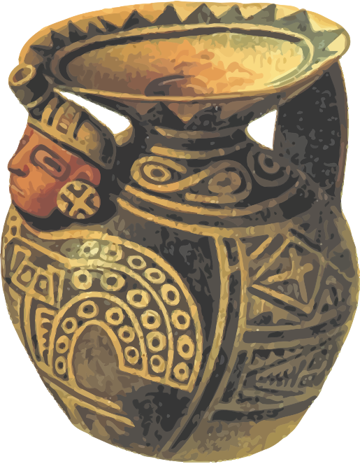
Origin of Ceramics
"
Ceramics is one of the most ancient industries going back thousands of years. Once humans discovered that clay could be found in abundance and formed into objects by first mixing with water and then firing, a key industry was born.
The earliest ceramics made by humans were pottery objects (pots or vessels) or figurines made from clay, either by itself or mixed with other materials like silica, hardened and sintered in fire. Later, ceramics were glazed and fired to create smooth, colored surfaces, decreasing porosity through the use of glassy, amorphous ceramic coatings on top of the crystalline ceramic substrates.
"
10

Slide 8
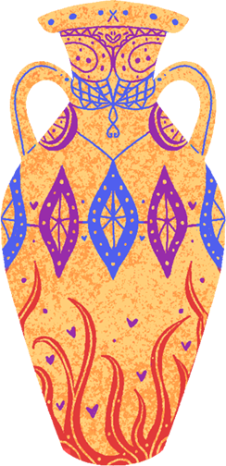
Origin of Ceramics
"
The oldest known ceramic artifact is dated as early as 28,000 BCE , during the late Paleolithic period. It was the statue of a woman from a small prehistoric settlement near Brno, in the Czech Republic.The first examples of pottery appeared in Eastern Asia several thousand years later.
Since these ancient times, the technology and applications of ceramics (including glass) has steadily increased. We often take for granted the major role that ceramics have played in the progress of humankind.
Ceramics now include domestic, industrial and building products, as well as a wide range of materials developed for use in advanced ceramic engineering, such as in semiconductors.
"
10

Slide 9
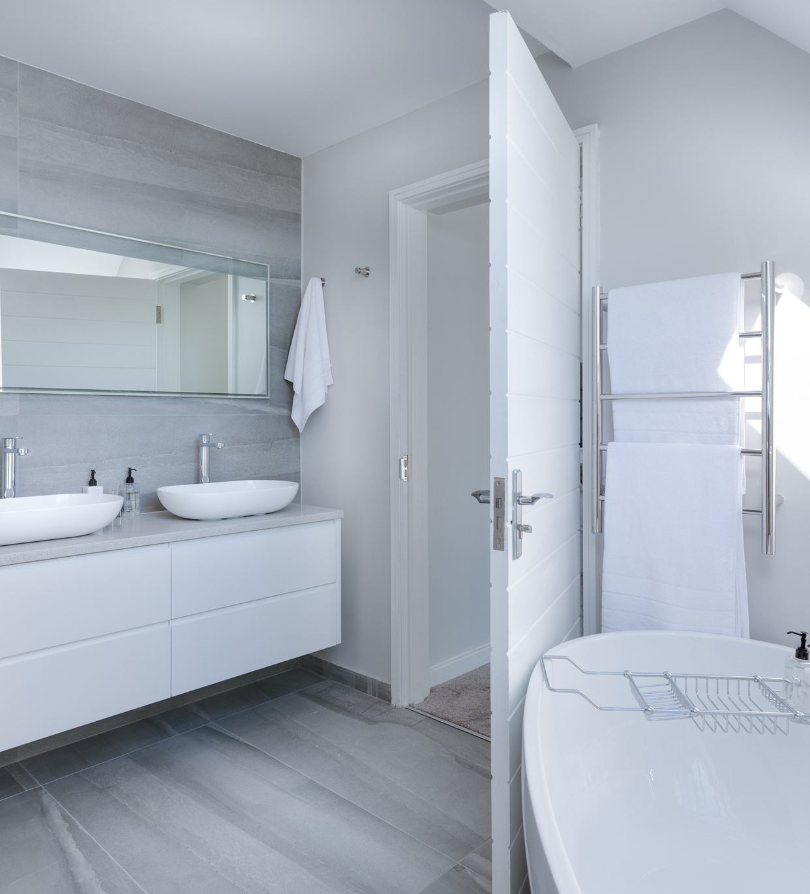
Properties

Slide 10

Chemical Properties
Strength:
Thermal Conductivity:
Electrical Conductivity:
Strength of metal>Strength of Ceramics>Strength of Polymer
Thermal conductivity is negligible in case of ceramics and possess high heat insulation capability
Electrical conductivity is negligible in case of ceramics due to absence of free electrons.
Brittleness:
Corrosiveness:
Hazardous:
The ceramics are brittle in nature.
Ceramics are generally anti-corrosive.
It is not hazardous to the environment.

Slide 11

Chemical Properties
Purity:
Pure ceramics are very anti corrosive and are said to be very strong (4 times stronger than glass)
Corrosion Resistance:
When it comes to the corrosiveness of acids and bases, ceramics are an ideal material for long-lasting performance resulting from their ability to withstand breaking down. Corrosion resistance is measured by testing ceramics against other alternative materials, such as metals and plastics, that are chemically soluble.
Biocompatibility:
Biocompatibility measures material performance in a specified application, identifying benefits or undesirable effects when combined with various biological hosts, such as body tissue or food material. Bioinert ceramics can be used for orthopaedic implants and in other medical device components because they won’t produce a toxic or immunological response. Most technical ceramics are also NSF food grade compliant.

Slide 12

Mechanical properties
The most important general property of ceramics is that they're refractory (resistant to decomposition by heat, pressure, or chemical attack, and retains strength and form at high temperature).Ceramic compounds are very resistant and don't wear for 10-100 years.
●They have poor impact strength.
●Ceramics usually have high compressive strength.
●They are extremely stiff and rigid.
●Ceramic products are hard, having a high softening temperature.
●Poor thermal shock resistance.
BRITTLE
HARDNESS
ELASTIC MODULUS
DENSITY
DUCTILITY
HIGH
HIGH
HIGH
LOW
LOW

Slide 13
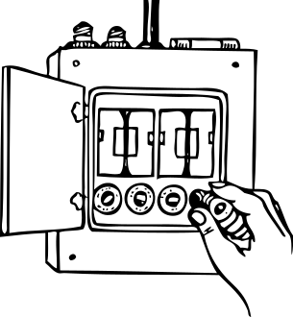
Electrical properties
●Usually electrical insulators (due to ionic-covalent bonding)although some exhibit semiconducting and conducting behaviour also.
●Some ceramics especially quartz exhibit piezo-electrical behaviour (the ability of certain materials to generate an electric charge in response to applied mechanical stress.) under which a mechanical loading generates potential difference across its surfaces.
●Ceramics also widely used in the production of lasers.
●Ceramic compounds are generally dielectric in nature. (materials, having very low electric conductivity, but supporting electrostatic field or ability of a material to prevent electron conductivity at high voltage.
Superconducting properties
● Despite of very low electrical conductivity of most of the ceramic materials, there are ceramics,
possessing superconductivity properties (near-to-zero electric resistivity).

Slide 14
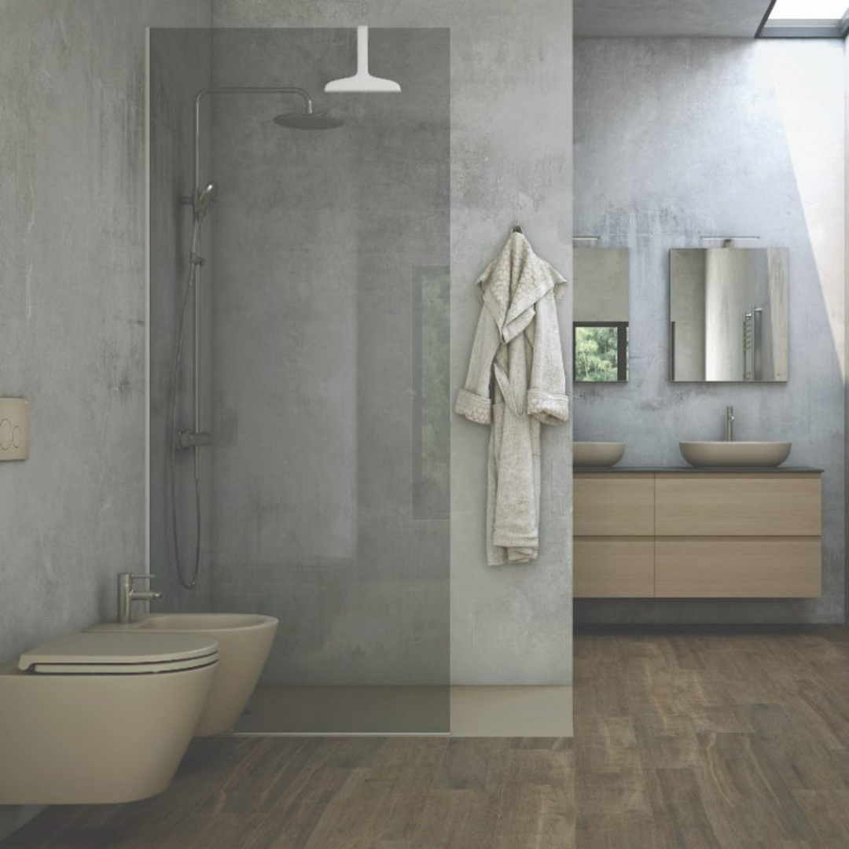
Classification

Slide 15
Fired Bricks
Glass Ceramics
Tough
Brittle
Heavy
Survive higher
temperatures
Zero porosity
Mechanical strength
Durability
High temperatures
Translucency
Biocompatibility
‍Silicon Carbide
Tough and extremely hard
Semiconductor
Naturally colorless
Low thermal development.

Slide 16
‍Tungsten Carbide
Dense
Hard
Tough,
Low electrical resistivity.
Silicon
Titanium Carbide
Brittle
Hard crystalline solid
Semiconductor
Heat resistance
Extremely hard
Black color

Slide 17
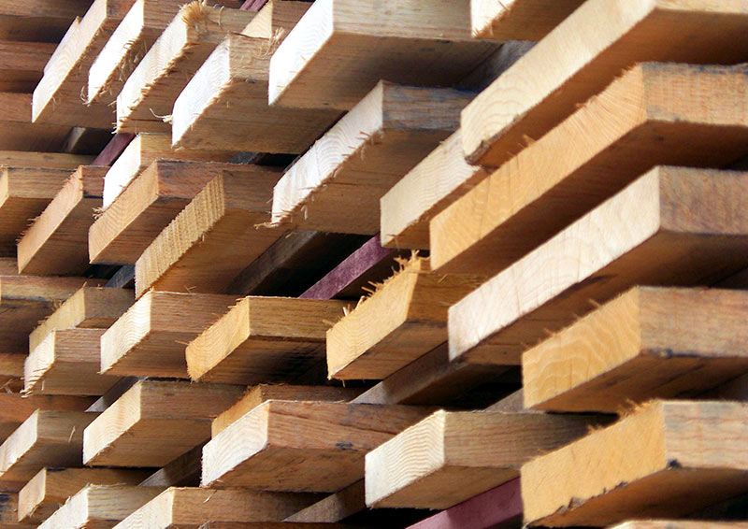
USES OF
CERAMICS

Slide 18
Bricks: Fried bricks are used in modern construction work.
Refractory and Insulation: Specially fried bricks are used for the inner lining of furnaces used for melting.
Household Utensils: Ceramics are used in the production of chinaware, earthenware, stone ware and porcelain.
Stonewares: Stonewares are used for constructing sanitary fixtures, such as sinks and bath tubs.
Glass : Glass is used to make household glassware, decorative items, and optical lenses.

Slide 19
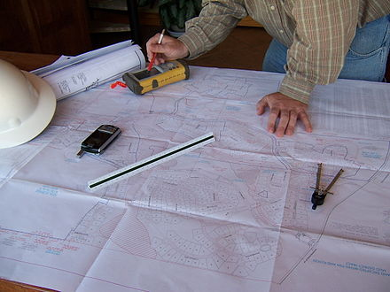
Advantages And Disadvantages

Slide 20
Advantages
Disadvantages
Most of them have high hardness hence they are used as abrasive powder and cutting tools
They have high melting point which makes them excellent refractory material
They are good thermal insulators this is another reason to use them as refractory material
They have high electric resistivity which makes them suitable to be used an insulator
They have low mass density which results in lightweight components
They are generally chemically inert which makes them durable
They are brittle in nature
They have almost zero ductility
They have poor tensile strength
They show a wide range in the variation of strength, even for the identical specimens
They are difficult to shape and machine

Slide 21
Thank You

